Slide 1
Information Management Working Group – IMWG
1
INSARAG Team Leaders meeting 2024 - Brasil

Slide 2
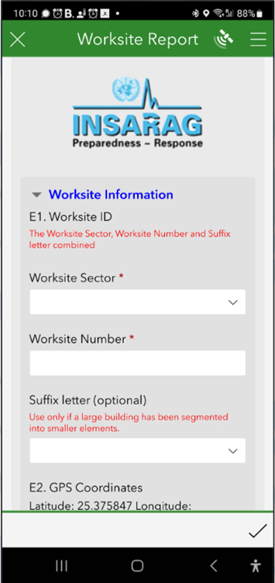
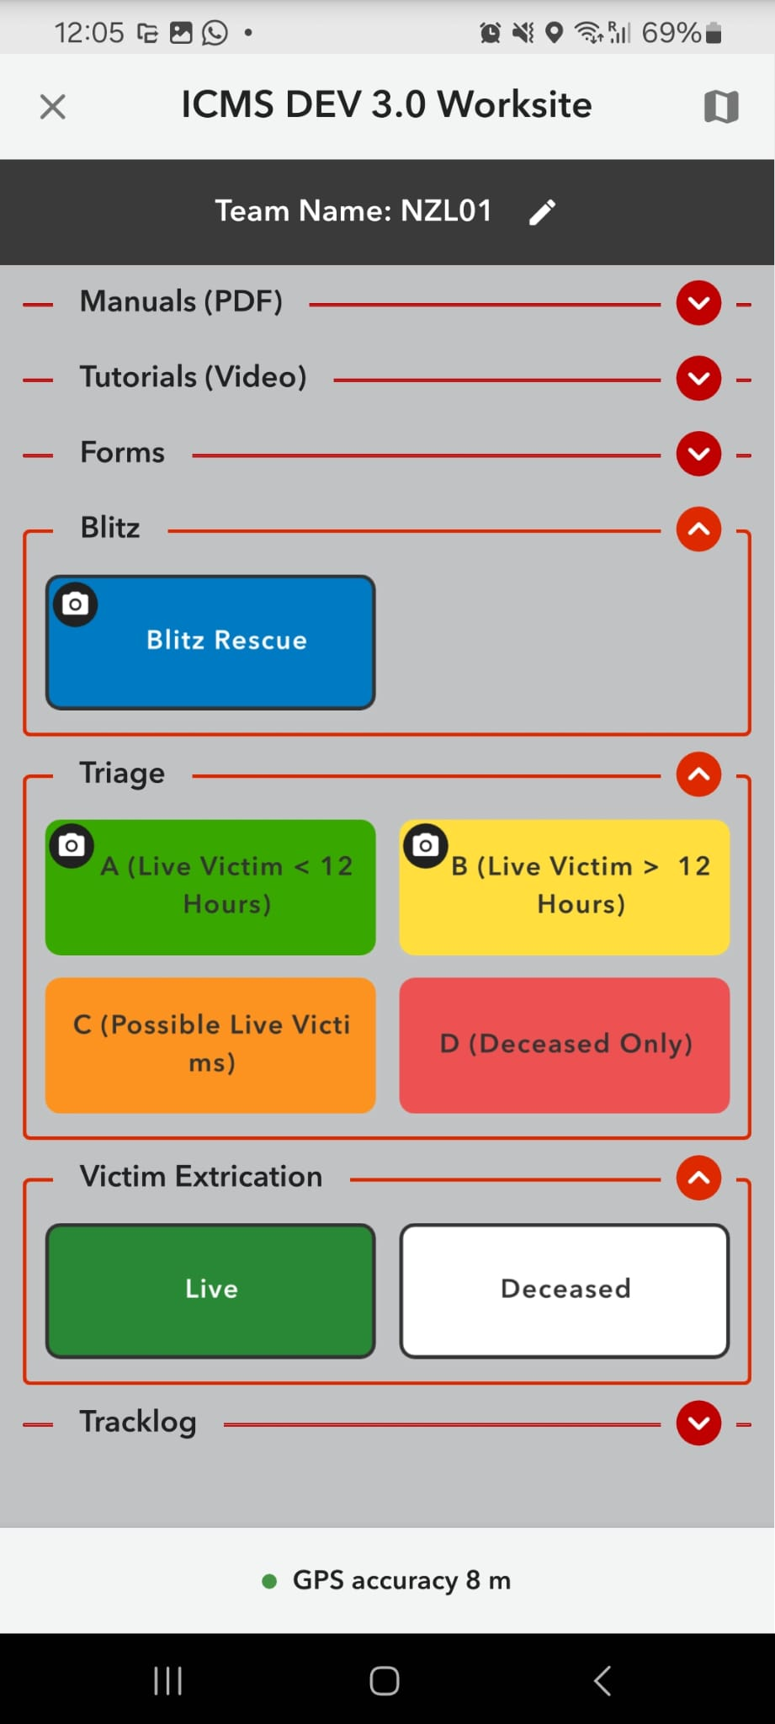
Content
Key Focus 2024/25
TOR
Qatar AAR Outcomes
Other Qatar Outcomes / Expanded Role
ICMS 3.0
Strategy
Sponsorship / support
Example / Feedback

Slide 3
Terms of Reference
The purpose of the IMWG is to deliver and promote the effective use of information management (IM) solutions across the INSARAG network
The purpose of the IM solutions are to support INSARAG network and its partners to manage USAR operations as outlined in the INSARAG guidelines and guidance notes (e.g. UC handbook and forms).

Slide 4
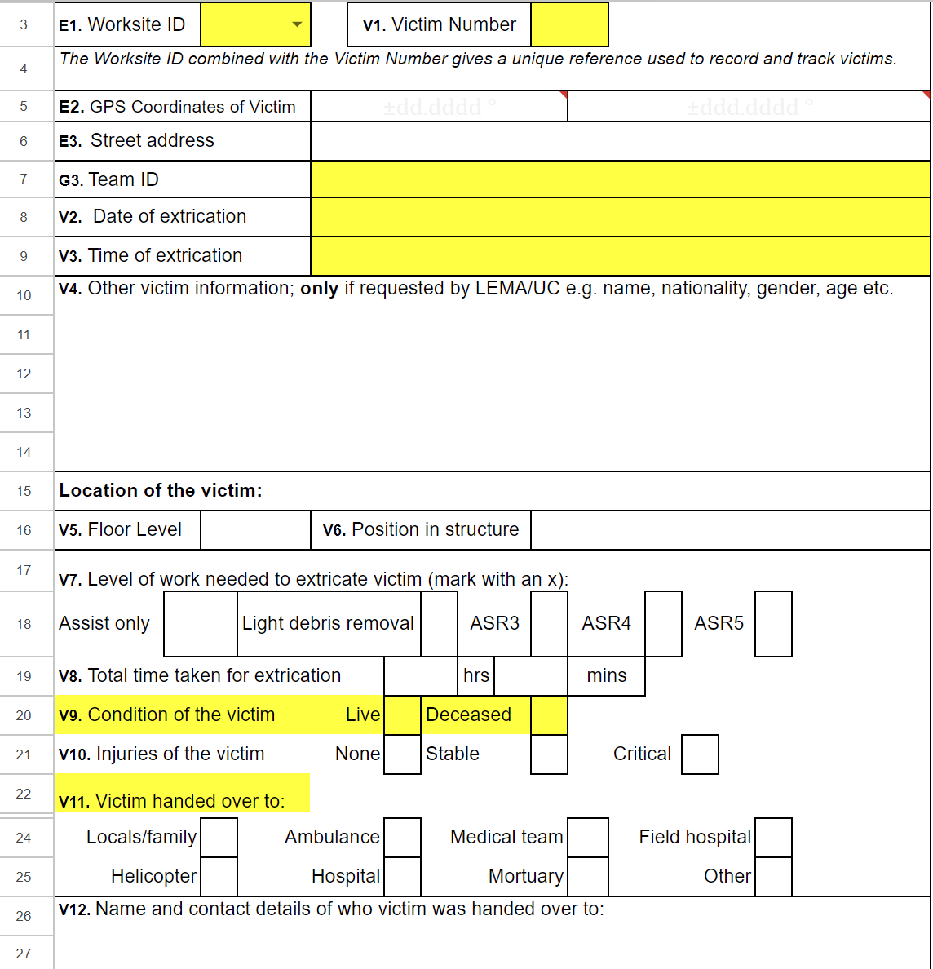
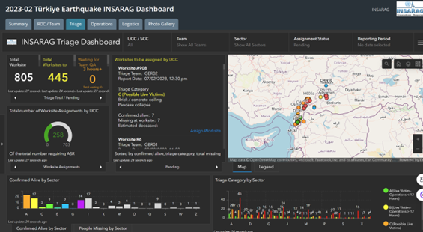
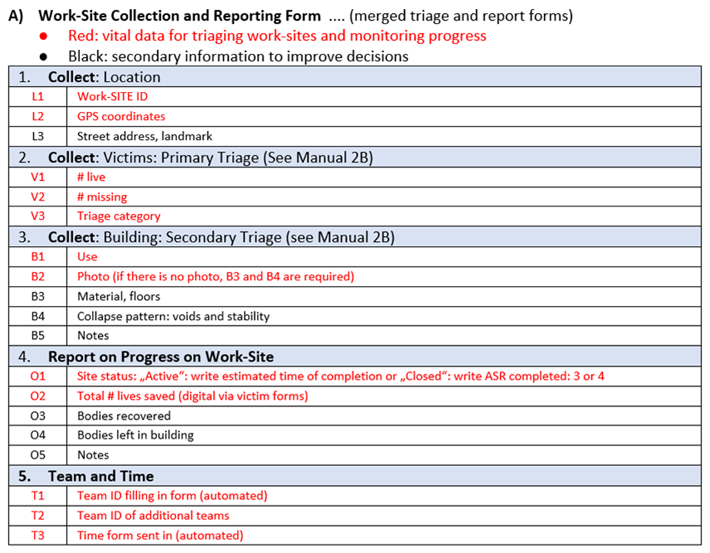
2. Qatar Outcomes IMWG
(Türkiye + Syrian Earthquakes)
Amount of data being collected
Introduce flexibility into system
Worksite ID de-linking from sector
VOSOCC – alignment of terminology and methods of use

Slide 5
3. Other Outcomes IMWG / Expanded Role
(Türkiye + Syrian Earthquakes)
Integration of other information (Satellite AI, Drones, Social media, etc)
Role of IMWG – Incident support + General information management
ICMS 3.0 changes to reflect the AAR outcomes
INSARAG.org

Slide 6
2.1 Simplification:
Data of Collection
Forms based data collection provide barrier to teams.
No data collected due to complexity and time required
New technology provides a more field focused solution.
Simplified data collection technology (QC) removes the challenges to field teams.

Slide 7

2.2 Flexibility:
Coordination layers
Coordination efforts hampered by limited scalability around coordination layers
Introducing a scalable system that can adjust to large scale events, while not overloading smaller events
Flexible and scalable coordination layers

Slide 8
2.3 Worksite Numbering
Example Worksite IDs
  NED01-0001
  BRA10-1345
  USA01-4834
  GER02-3944
  FRA11-3944
  All teams need to do is ensure uniqueness within their own team
Worksites are often identified prior to completion of sectorization
Many times, sectors are re-drawn as the incident evolves
Current plan is to delink sectors from worksite IDs

Slide 9
2.4 VOSOCC
Problems
Information flow chaotic
Too much randomly posted information that is not being found or not being used.
The VOSOCC is not a chat room.
VOSOCC is not the teams’ logbook.
Critical tool
Information from ERS
Information about request
Information from LEMA
ICMS link
Contact info for RDC/UCC/SCC
Team Fact sheet

Slide 10
2.4 VOSOCC Guidelines 2016 for USAR teams
Guidelines for USAR teams exist
What does the Virtual OSOCC offer to USAR teams?
What are USAR teams expected to post, when and where?
Do’s and Dont’s in the Virtual OSOCC
Next steps
We need to improve them
Then train the procedures well

Slide 11
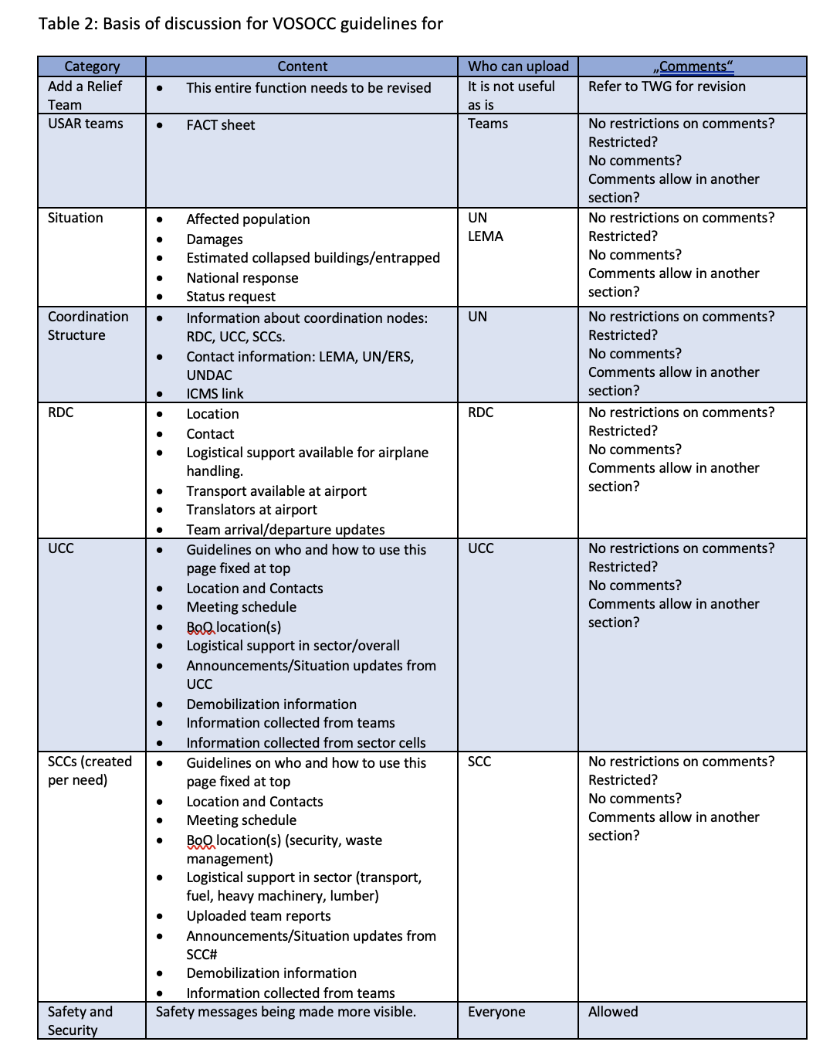
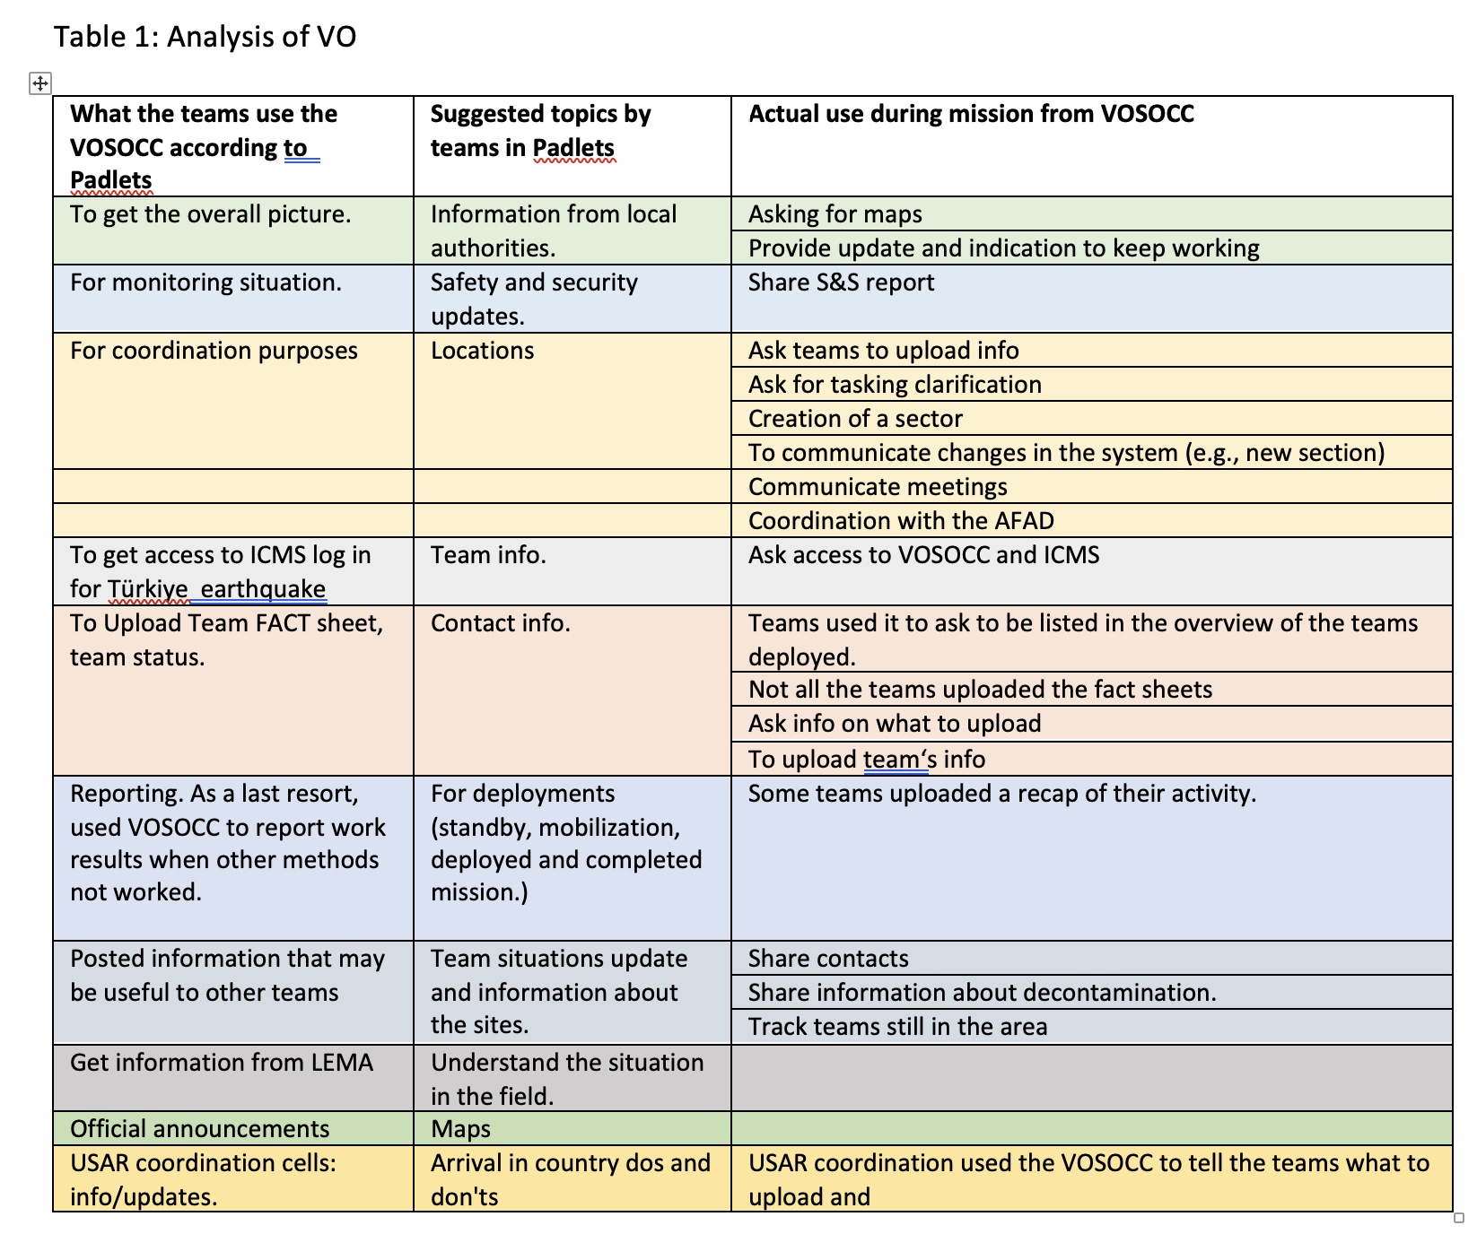
2.4 VOSOCC:
What (based on analysis)

Slide 12
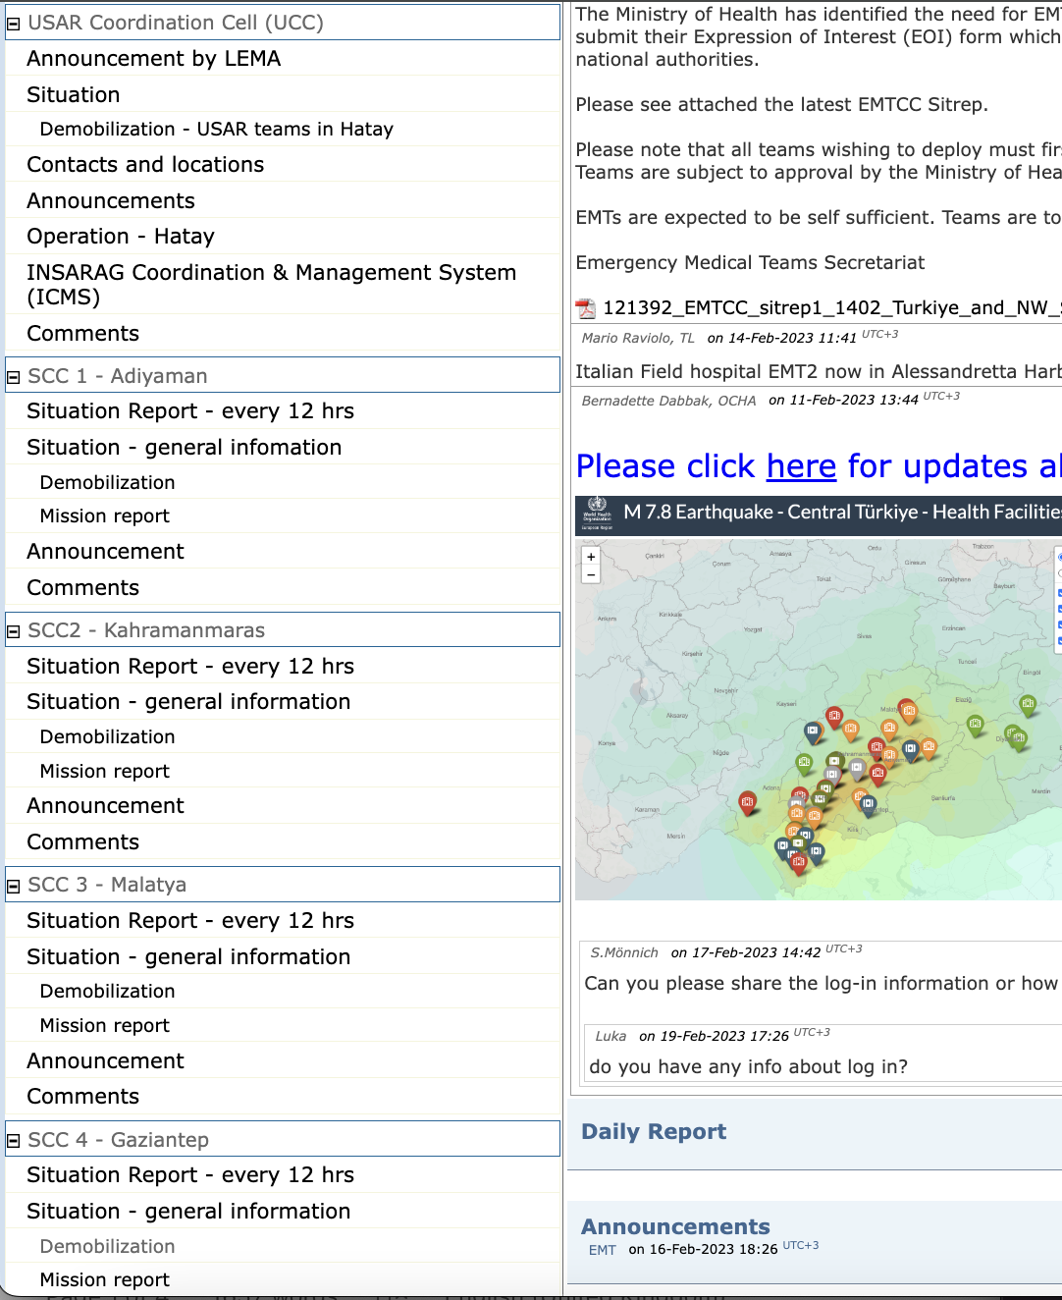
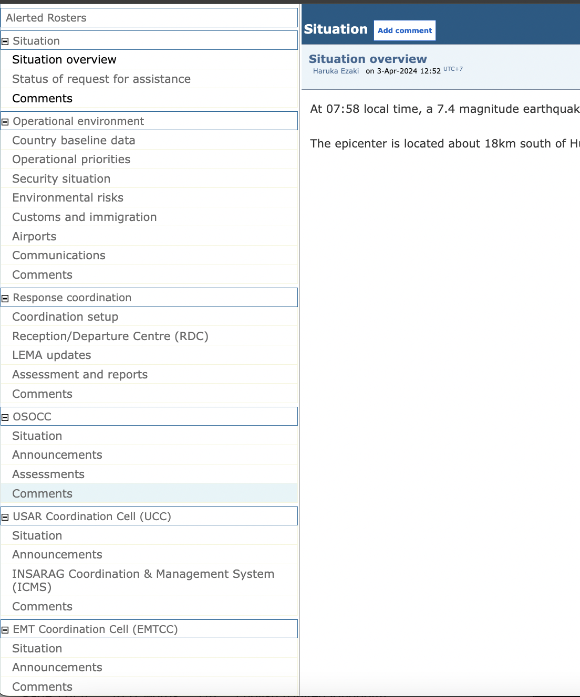
2.4 VOSOCC:
Where (use the experience from Turkiye)
Can we make an automated SCC part?

Slide 13
2.4 VOSOCC: Include Guidelines for Communication
One way communications – no comments allowed
  From UCC/SCC/RDC/LEMA – no comments allowed
Two way communication – a special comment section
  Communicate with UCC/SCC/RDC
  Information for all teams
Being disciplined
  No personal messages
Other means of communication
  Use other means (email, phone, messaging applications, etc.),
  If you can get on the VO that means you can get on email.

Slide 14
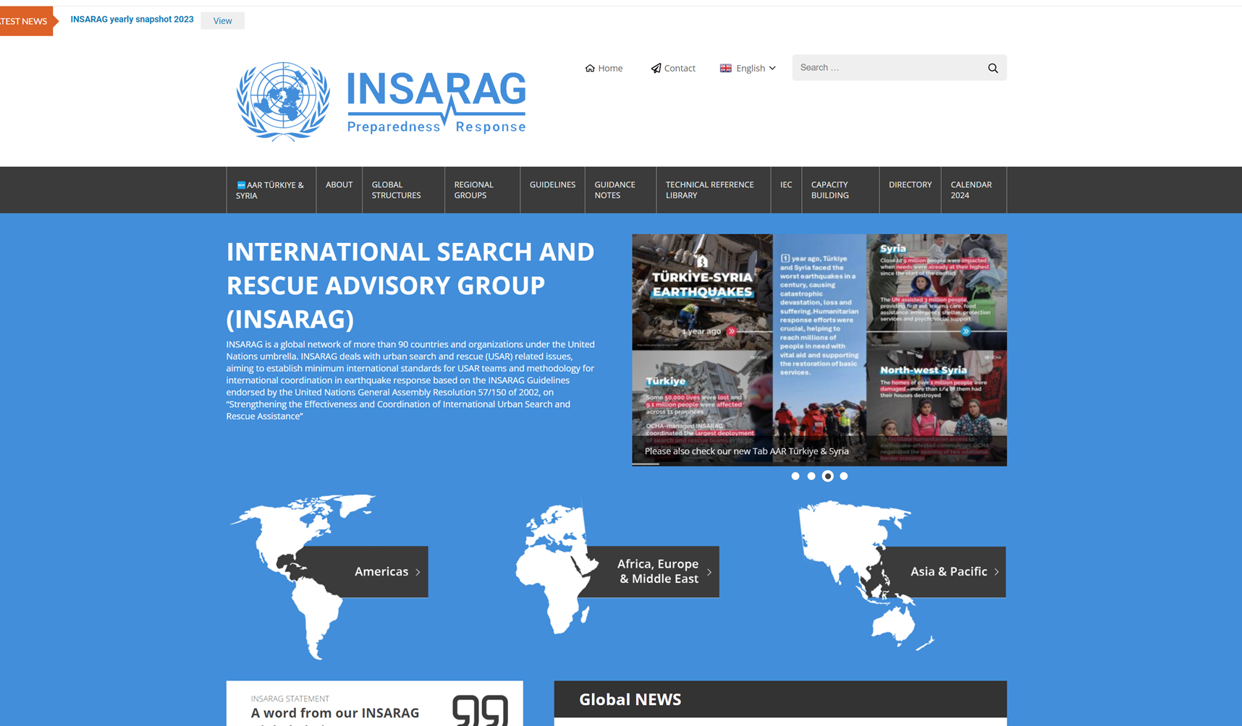
INSARAG.org
IMWG will manage the INSARAG website
Knowledge is power and power is not shared at this time
Updating website regularly
  we need your input here (insarag@un.org)
  Text, pictures graphs etc.
Simplify the different tabs (for example)
  Double check the submenu
  Re-name “FORMS” to “FORMS AND DISPLAYS”.
  Separate the “Guidance notes” to a separate tab
  we have to many duplication
Long before the ISG Meeting 2018 it was discussed "for ages" that within INSARAG knowledge has been created and was not shared, even as we all understand that our own INSARAG philosophy is based on that:
  knowledge sharing => capacity building.

Slide 15
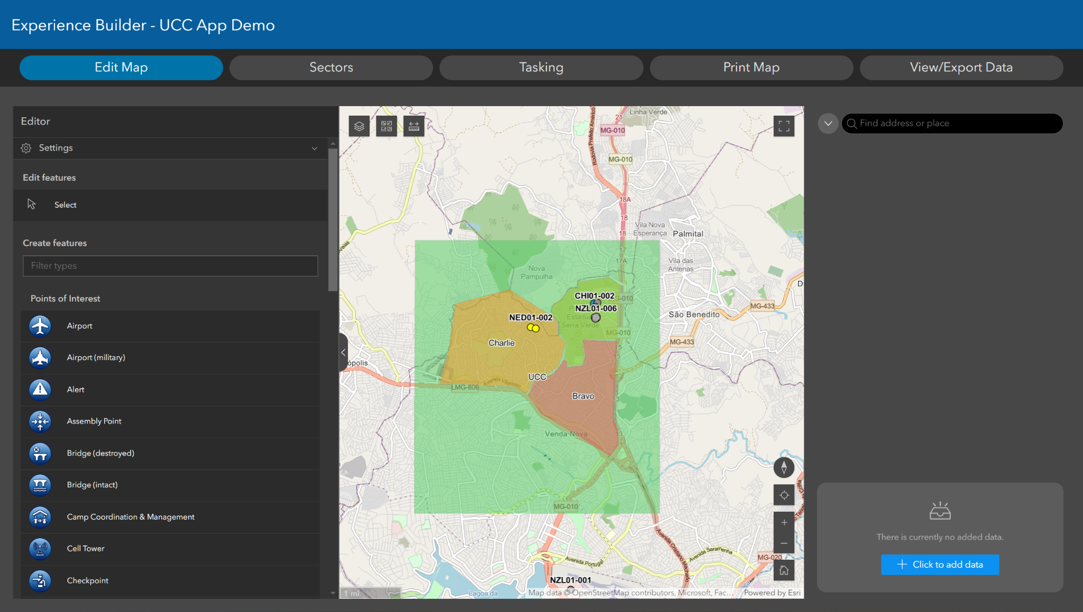
4. ICMS 3.0
Notes:
UCC app new interface

Slide 16
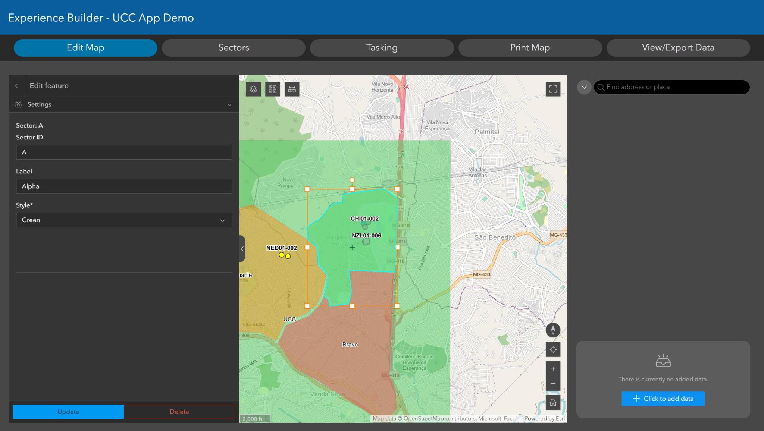
4. ICMS 3.0
Notes:
UCC creating sectors

Slide 17
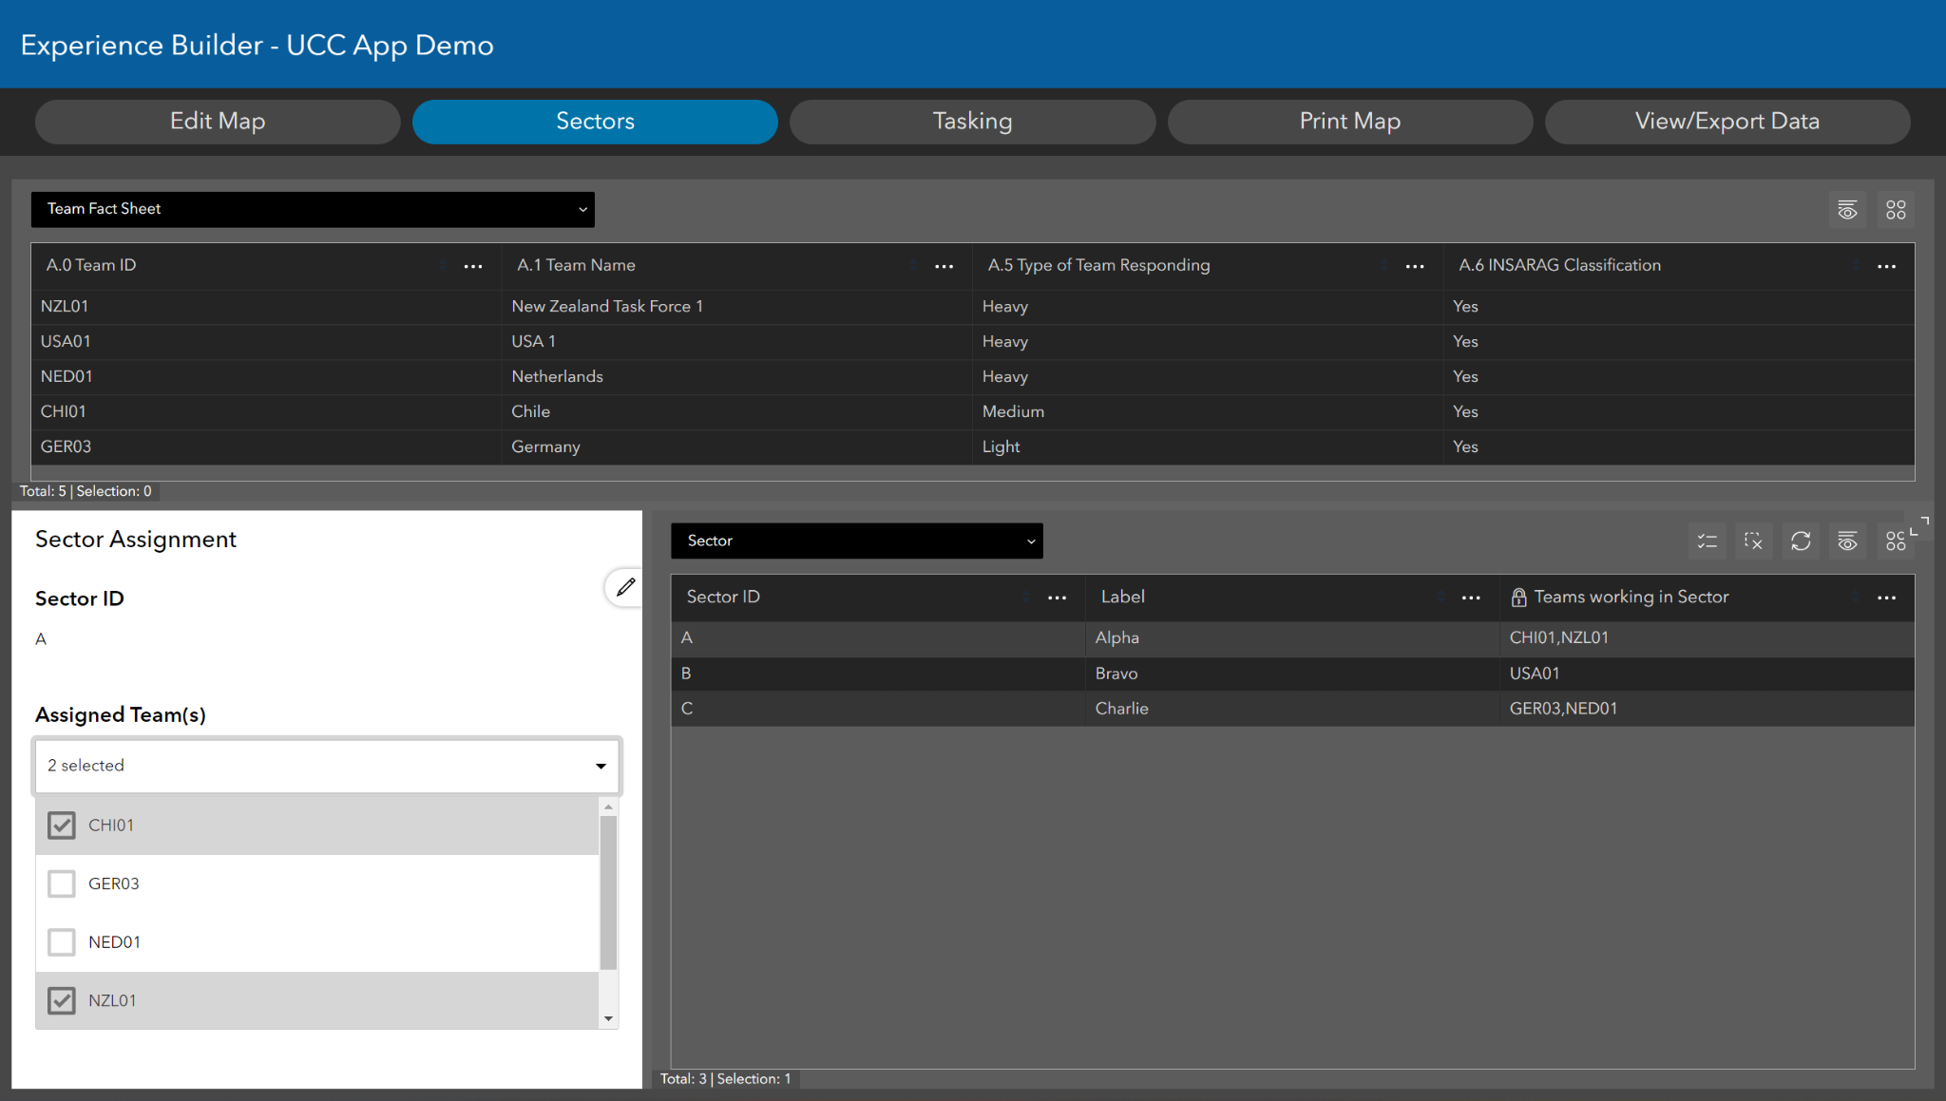
4. ICMS 3.0

Slide 18
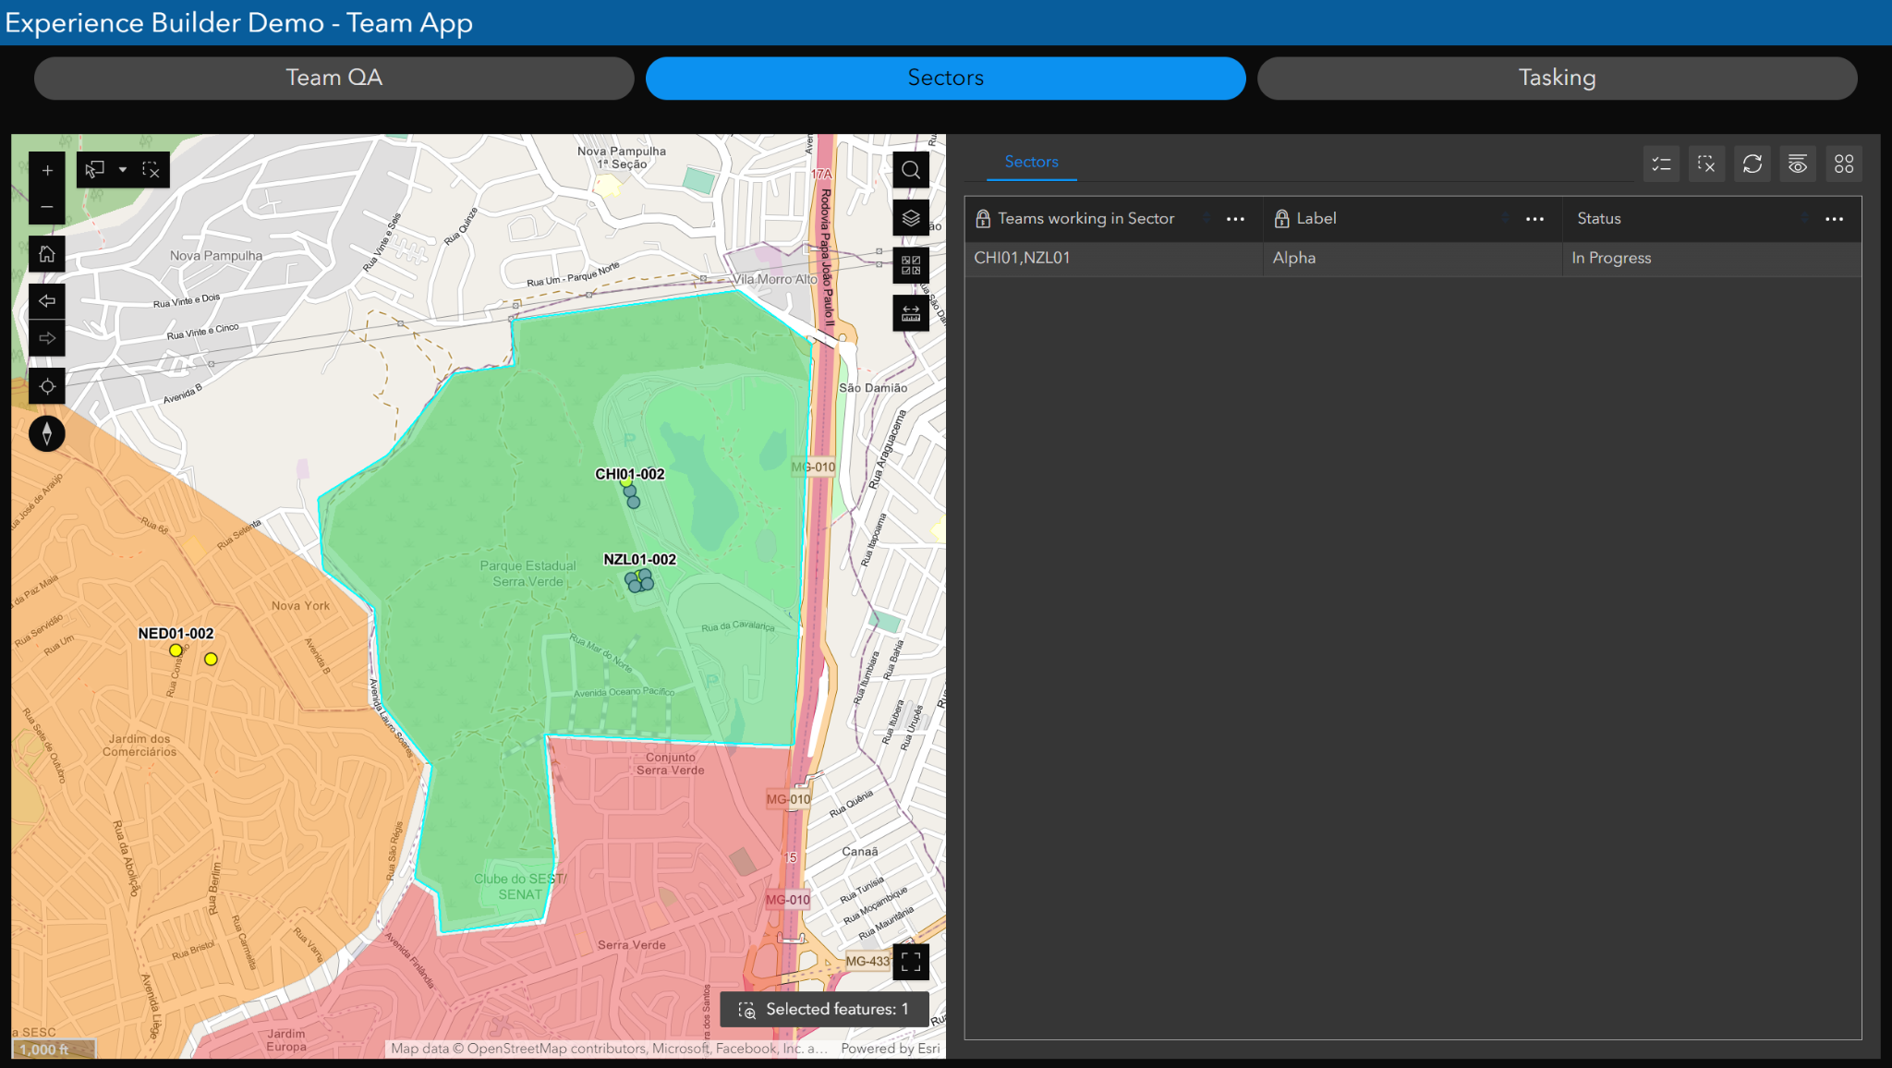
4. ICMS 3.0

Slide 19
4. ICMS 3.0

Slide 20
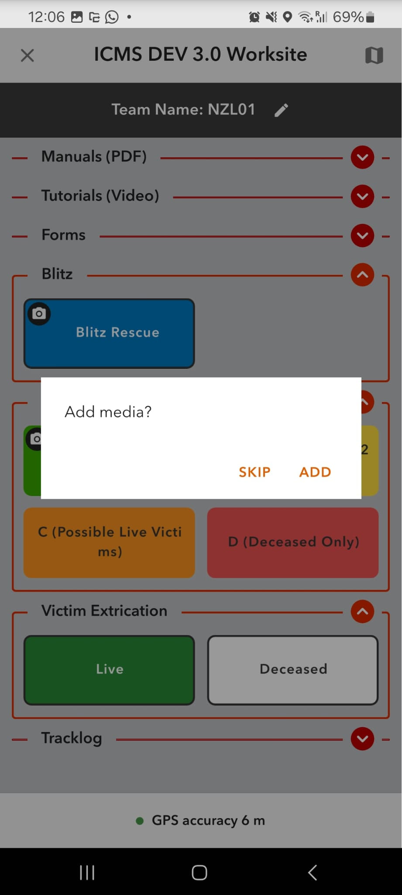
4. ICMS 3.0

Slide 21
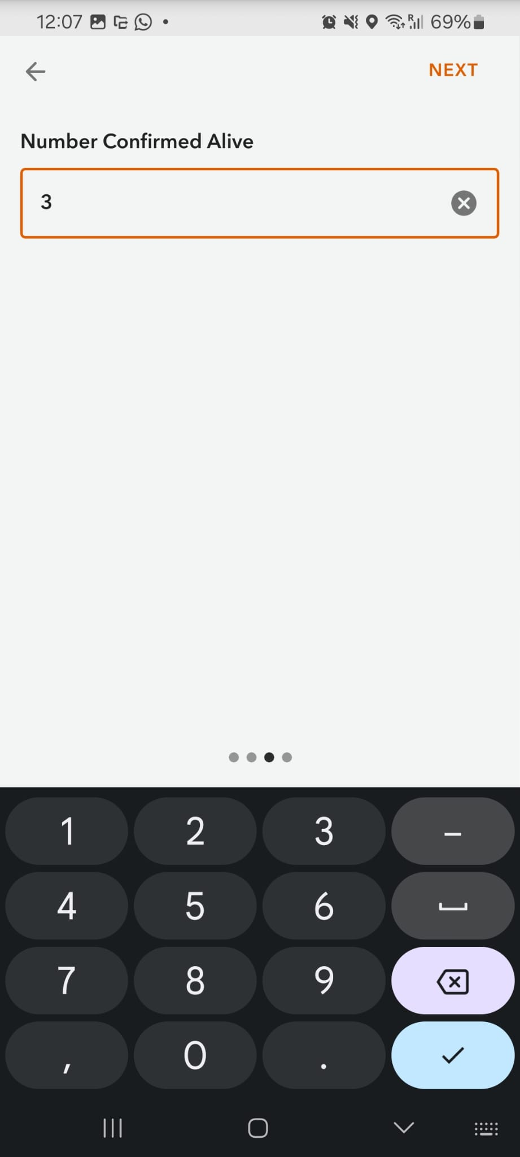
4. ICMS 3.0

Slide 22
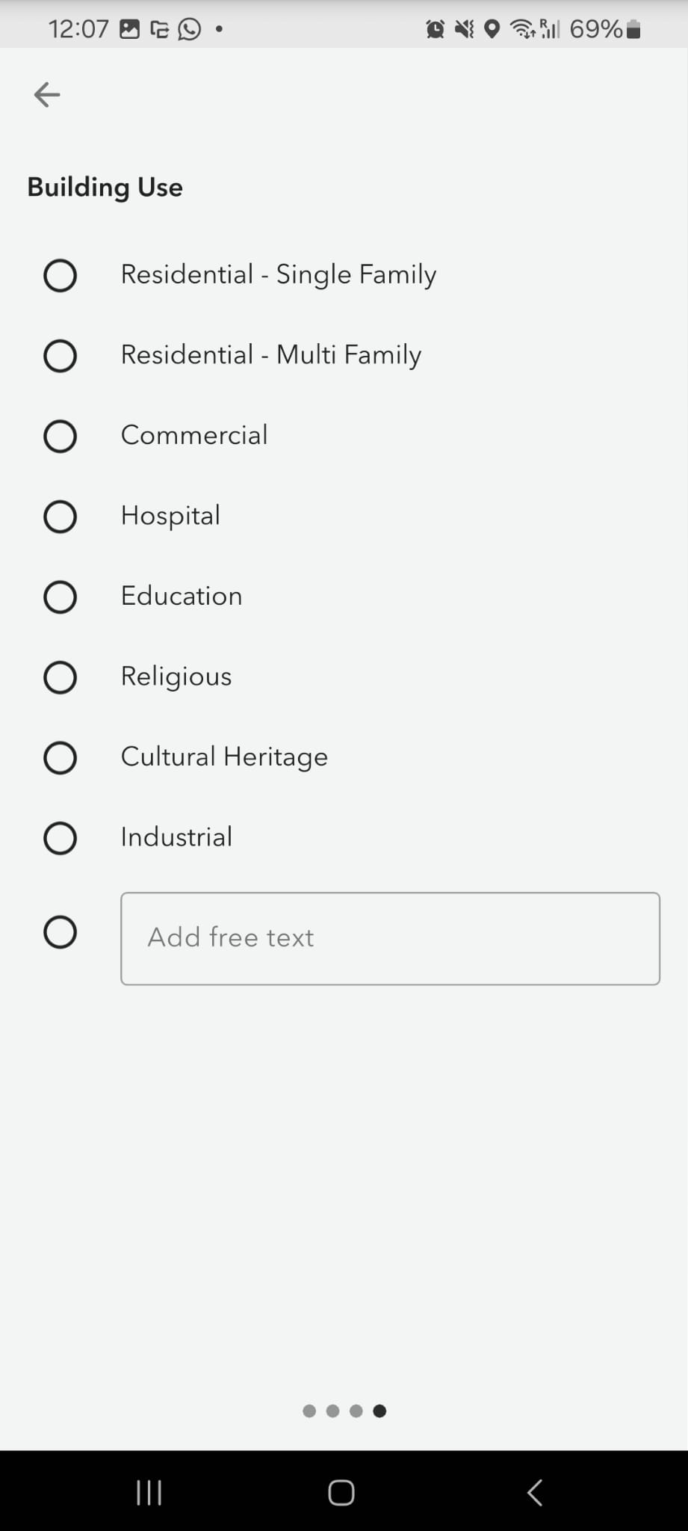
4. ICMS 3.0

Slide 23
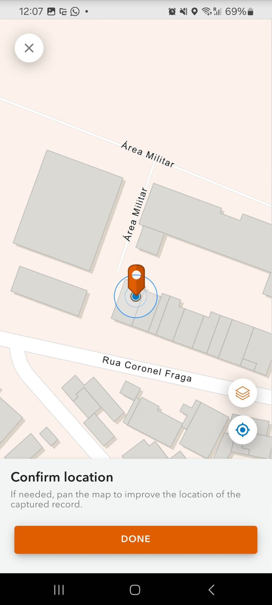
4. ICMS 3.0

Slide 24
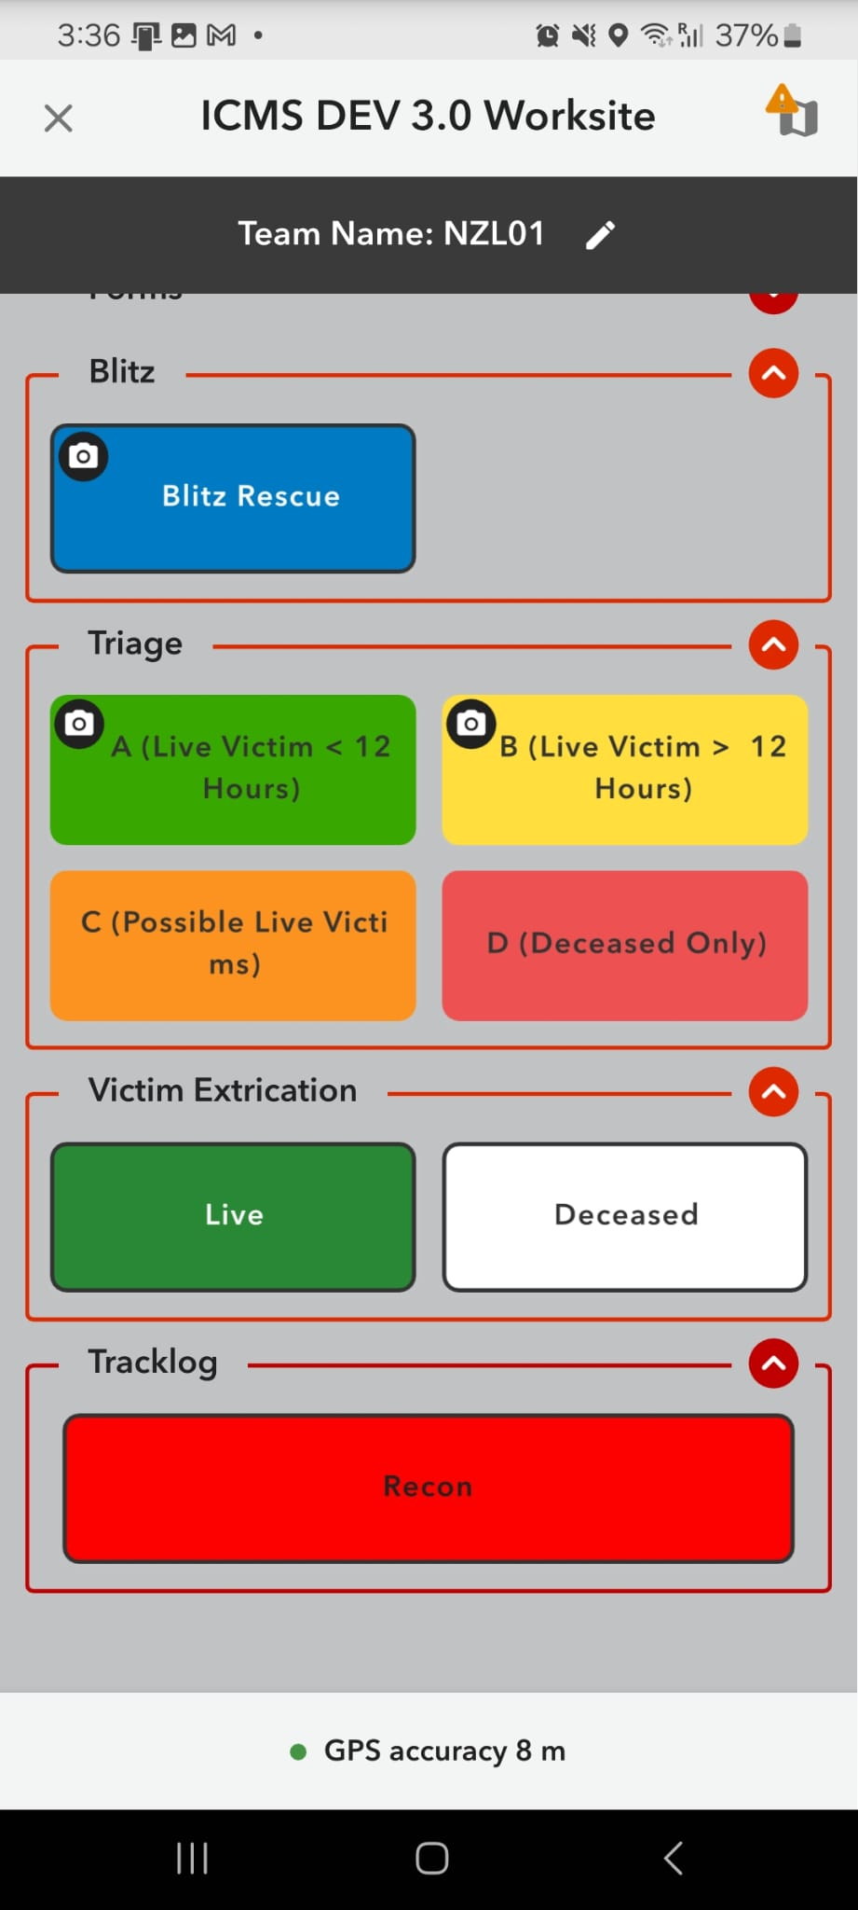
4. ICMS 3.0

Slide 25
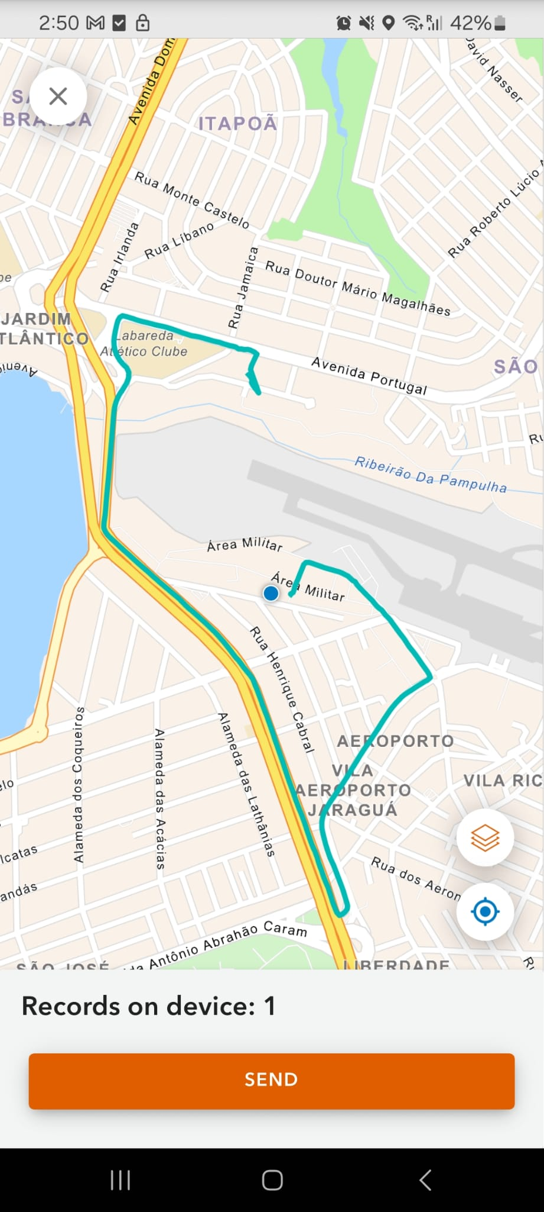
4. ICMS 3.0

Slide 26
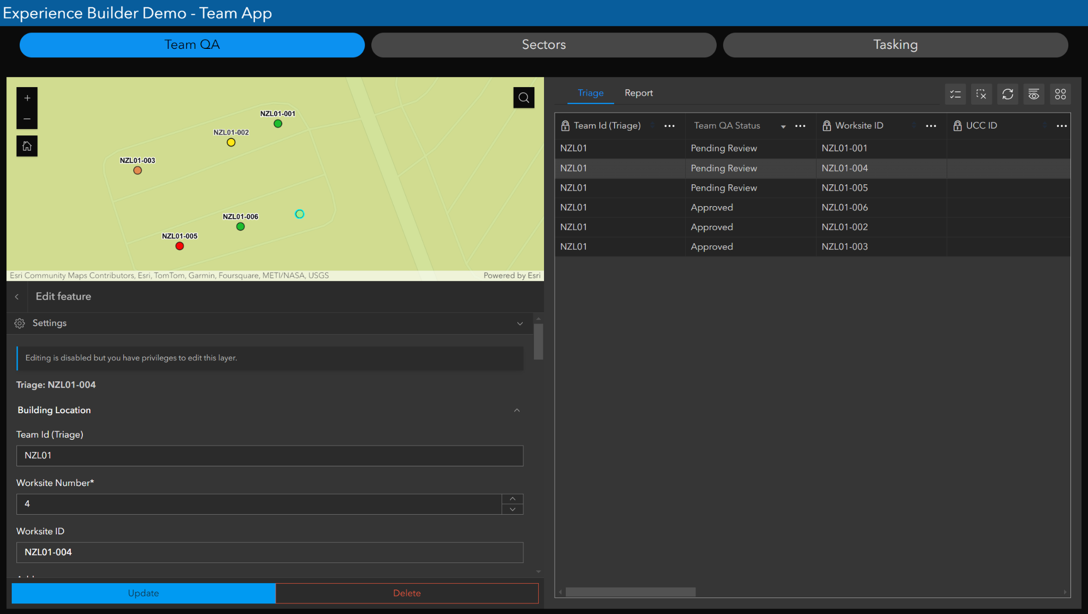
4. ICMS 3.0
Notes:
Team QA of records with new interface

Slide 27
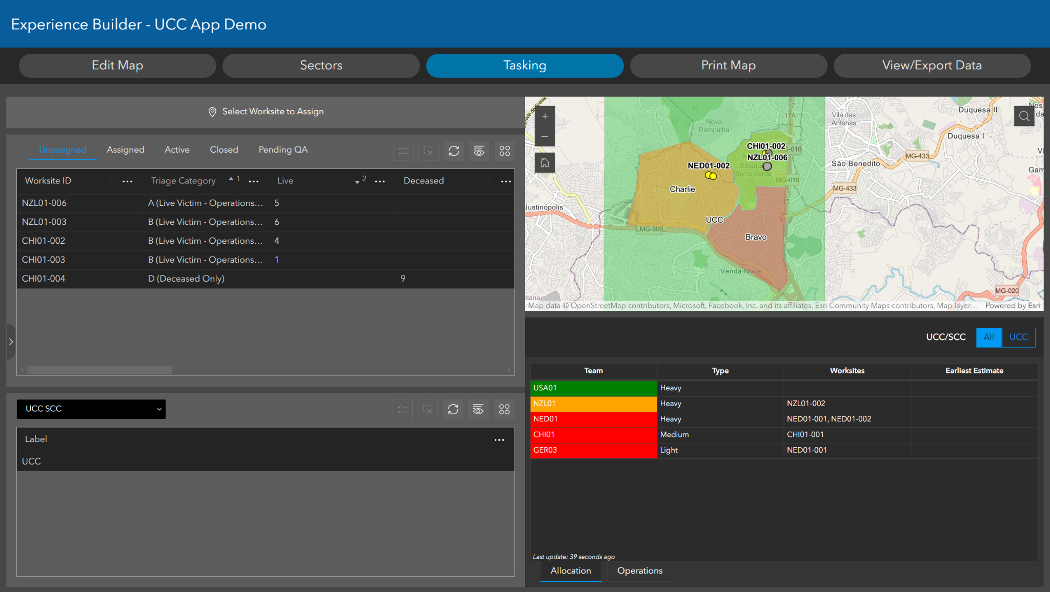
4. ICMS 3.0
Notes:
UCC tasking of worksites + team availability

Slide 28
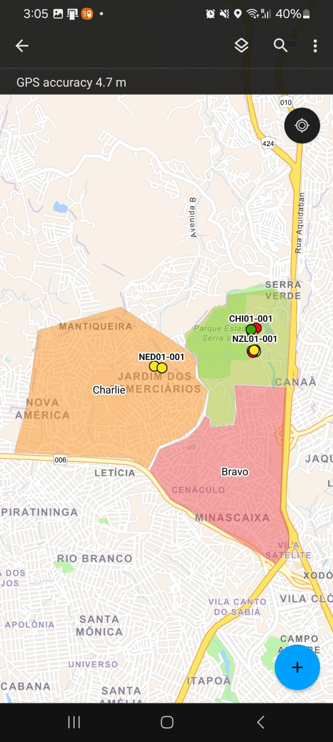
4. ICMS 3.0

Slide 29
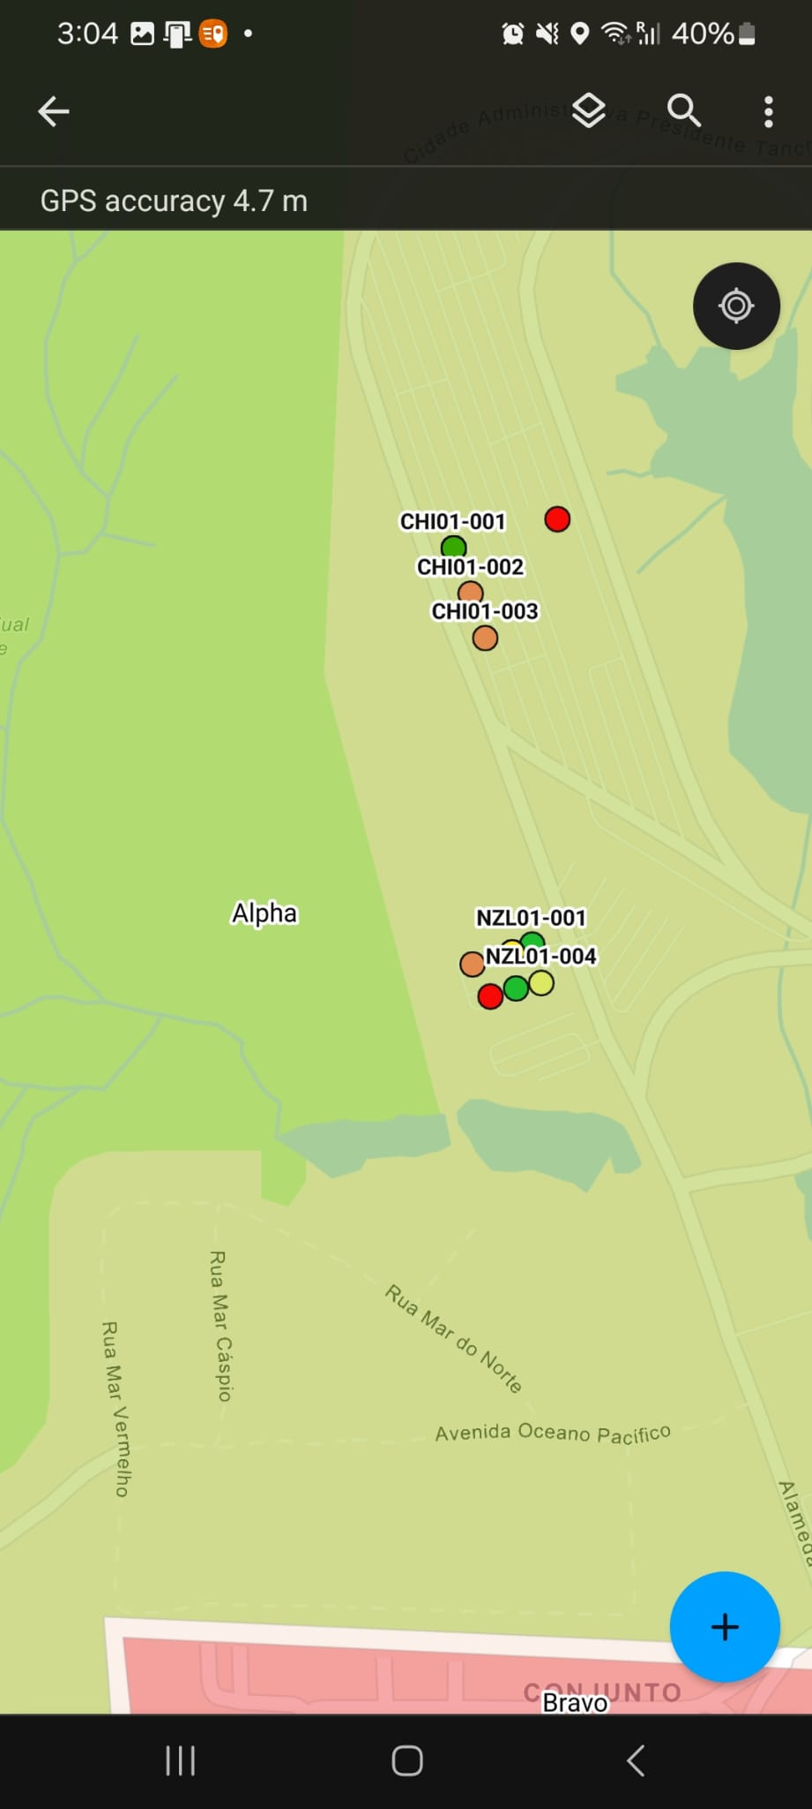
4. ICMS 3.0

Slide 30
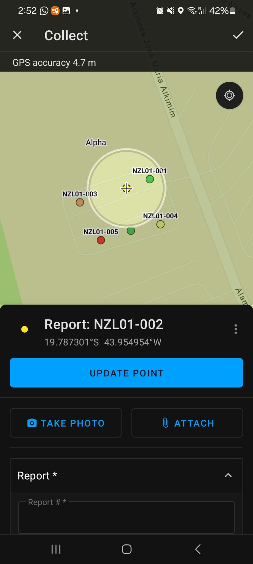
4. ICMS 3.0

Slide 31
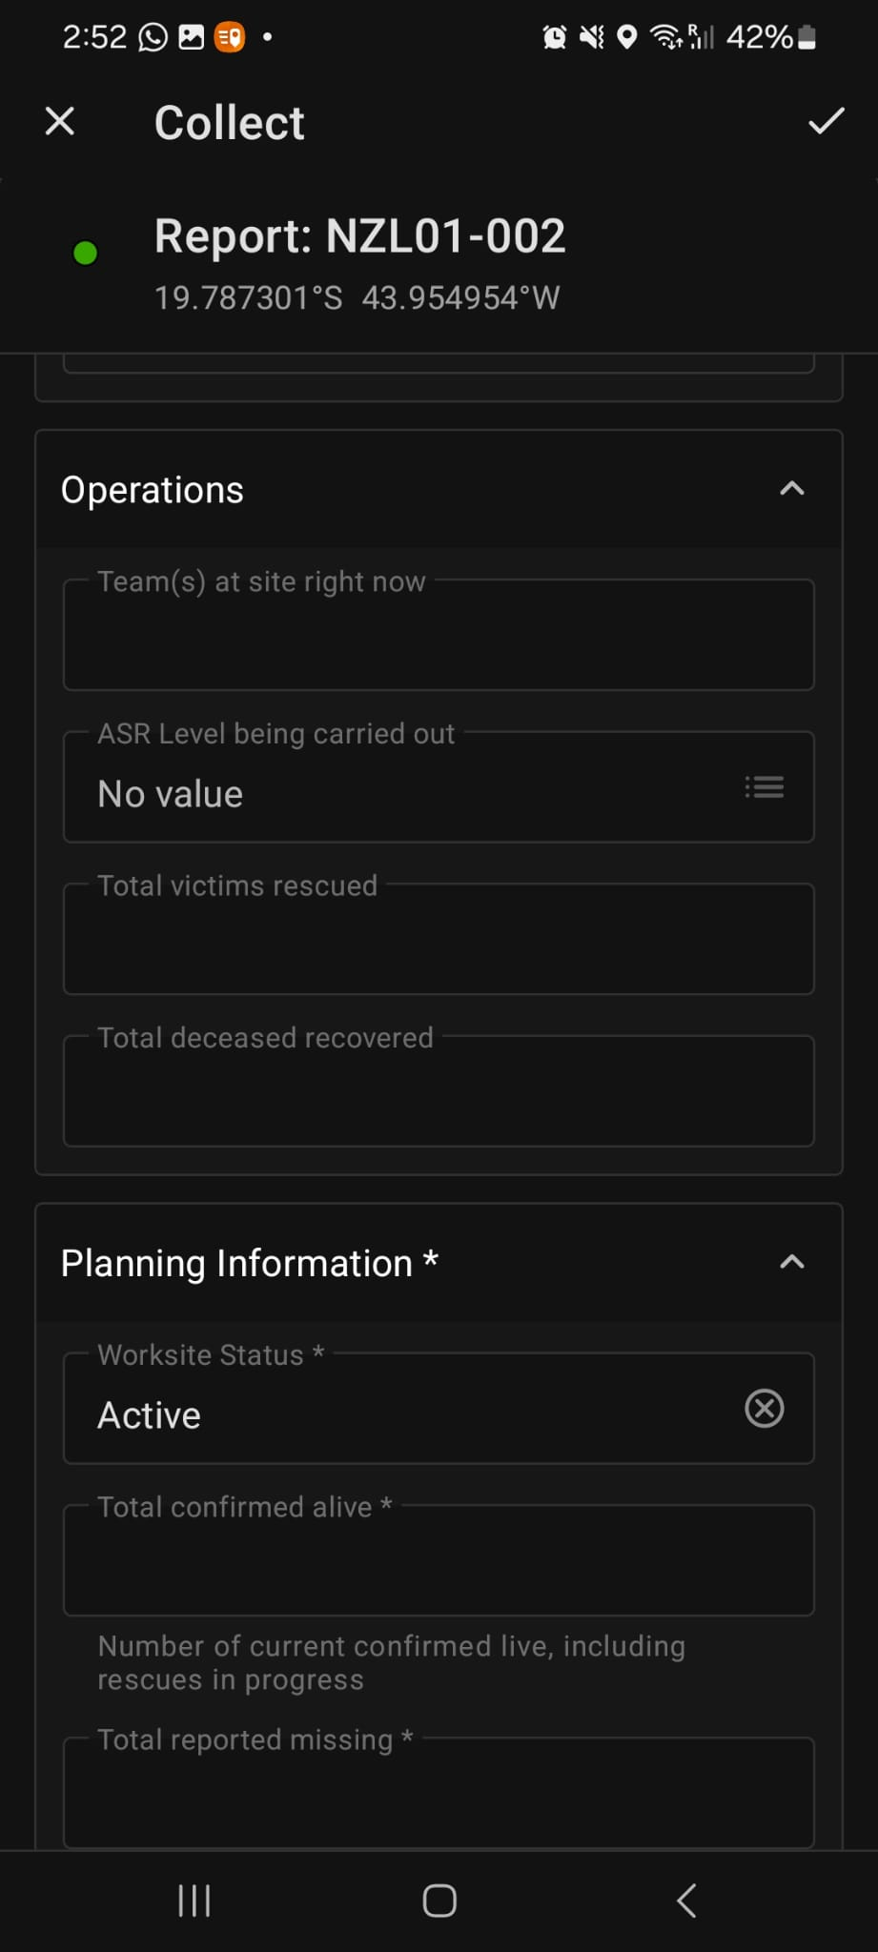
4. ICMS 3.0

Slide 32
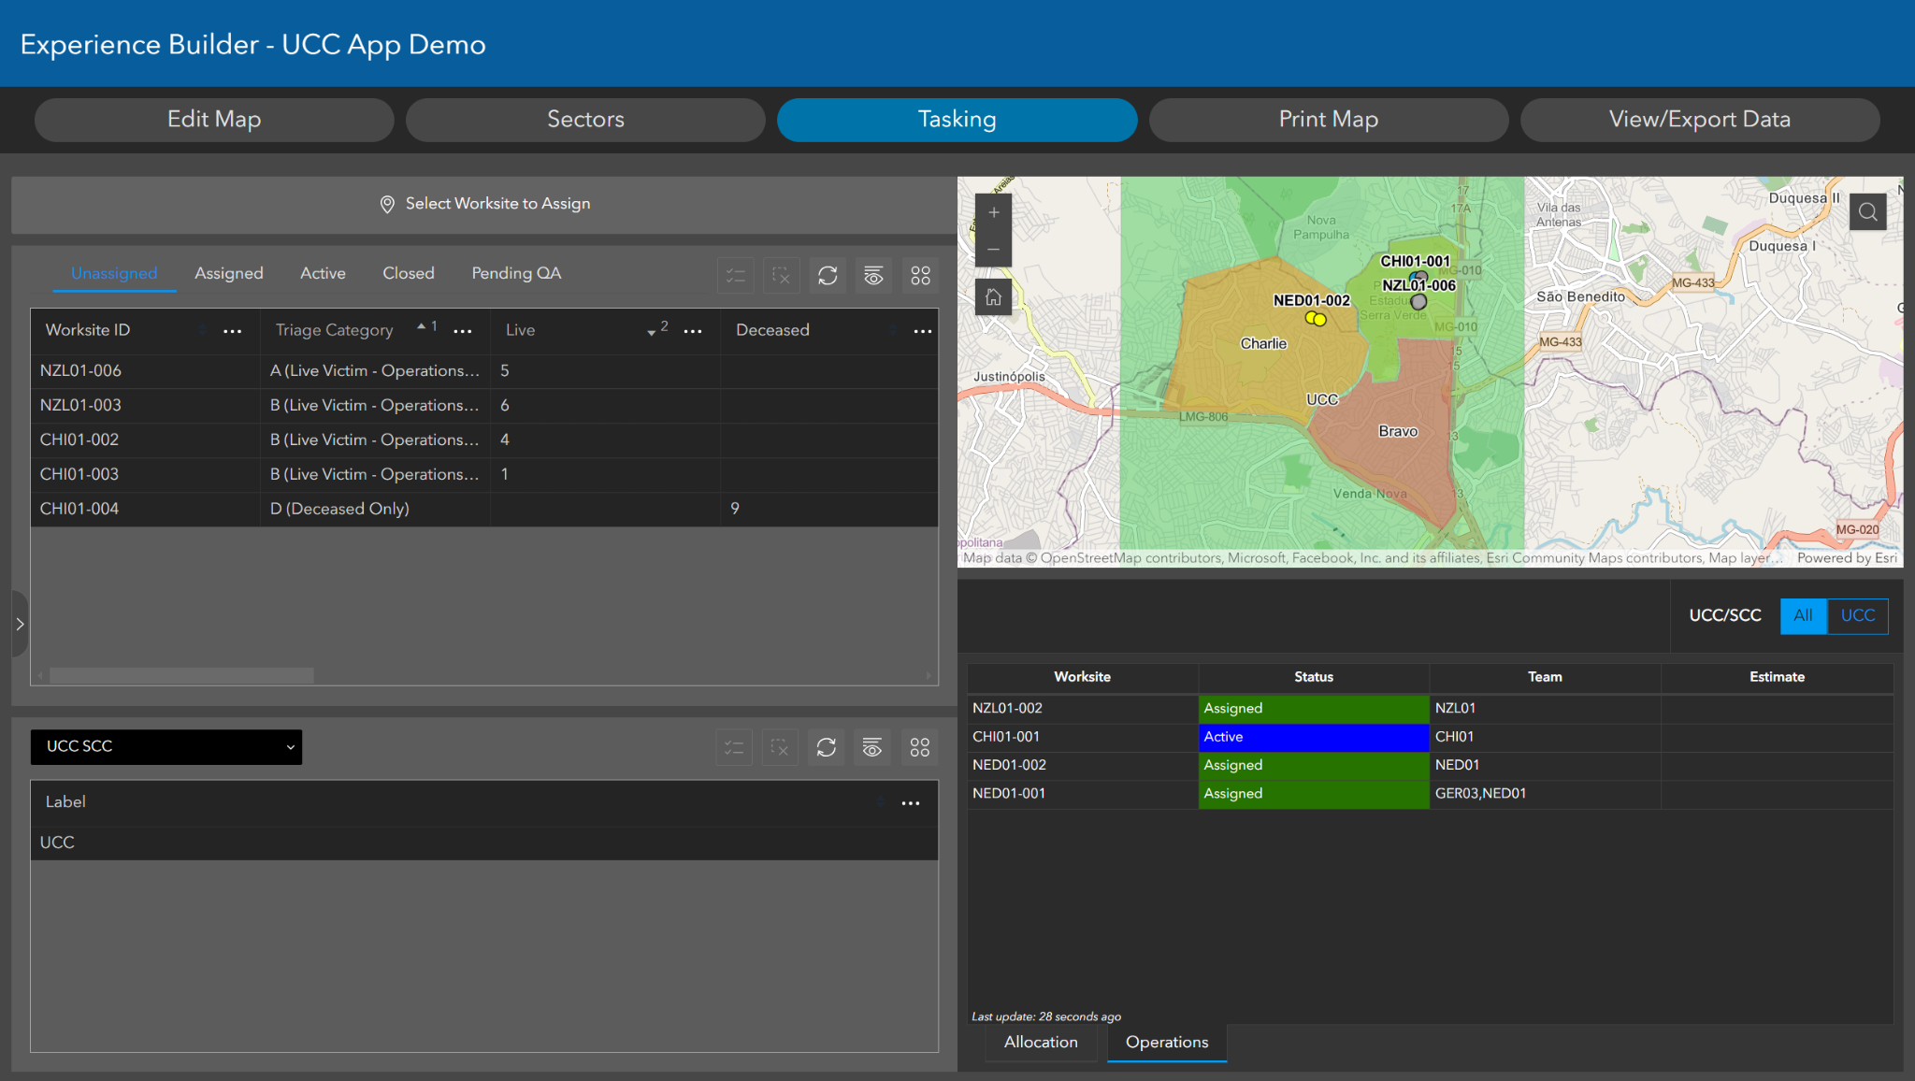
4. ICMS 3.0
Notes:
UCC seeing that teams are actively working a site

Slide 33
4. ICMS 3.0 Other Future Enhancements
Low bandwidth version of dashboard
  no map
  manual refresh
Squad level tasking

Slide 34
4. Timeline- ICMS 3.0
15 – 17 April 2024 Team Leaders Meeting – Consultation Proof of Concept ICMS 3.0
7 May 2024 ISG – Present Proposed Changes and Recommendations, Request for funding
2024 Regional Meetings – Progress Briefing and Consultation
2025 Team Leaders Meeting – Progress Briefing and Consultation
2025 ISG – Confirmation of Final Inputs
2025 Regional Meetings – Demonstration Final Version and Consultation
Team Leaders Meeting 2026 – Delivery ICMS 3.0 as a system
Full delivery will be aligned to guidelines delivery

Slide 35
5. IMWG Strategy 2024-2029
IMWG is developing a 5-year strategy for information management
Intent
Work plans (12 month)
Scope of work
Needs analysis
Timelines – Aligned GRG (Guidelines)
IMWG structures – portfolio’s (Management, Operations, Training, Technical, Support)
Network and partner engagement
Notes:
IMWG 5 year strategy acknowledges that IM is and enduring function within the INSARAG environment.
5 Year strategy seeks to enable IMWG to develop to meet infomation managemnt needs of the network.
The strategy will cover off a profesionalisation of the IMWG to eable it to support th eongoing needs of the Network.
• Portfolios
• Ongoing network engagement
• Development of products
• Broader Information management functions
• Operational support
• General support

Slide 36
6. IMWG Funding
Information management is an enduring function of INSARAG
Current system has been developed within IMWG
IMWG - 5 year strategy will inform goals and workplans
Professional products now require professional services (software development)
Licences – value of COTS vs Bespoke systems shown in flexibility to adjust ICMS to meet needs
Research and development; innovation - how we introduce new functions
Support services - peacetime support + Incident support
We have the endorsement of co-chairs
Endorsement of Team Leaders
Notes:
Key issues to mention:
ICMS is built by USAR people for USAR people - we control the design and function, but we need to get support fro developers ot continue to develop it s as an adaptable and flexible solution.
I’d like to recognize that ICMS was built by members of the USAR community, specifically Aidan Elliot of NZL-01, with support from John Hanke and John Morrison from USA-01.
USAR-NL has supported current developments directly
Endorsement from TL to progress to seeking funding from within the network to support the ongoing development of information systems

Slide 37


QR codes
1. Quick Capture
2. Mentimeter

